Slide 1

SHM Statistical Models
Presentation for 4th Year Project, Bio-Engineering Track, Faculty of Engineering, Bar Ilan University, Israel
Gilad Aviv & Yedidya Shimon, under the supervision of Daniel Einy and Prof. Gur Yaari

Slide 2
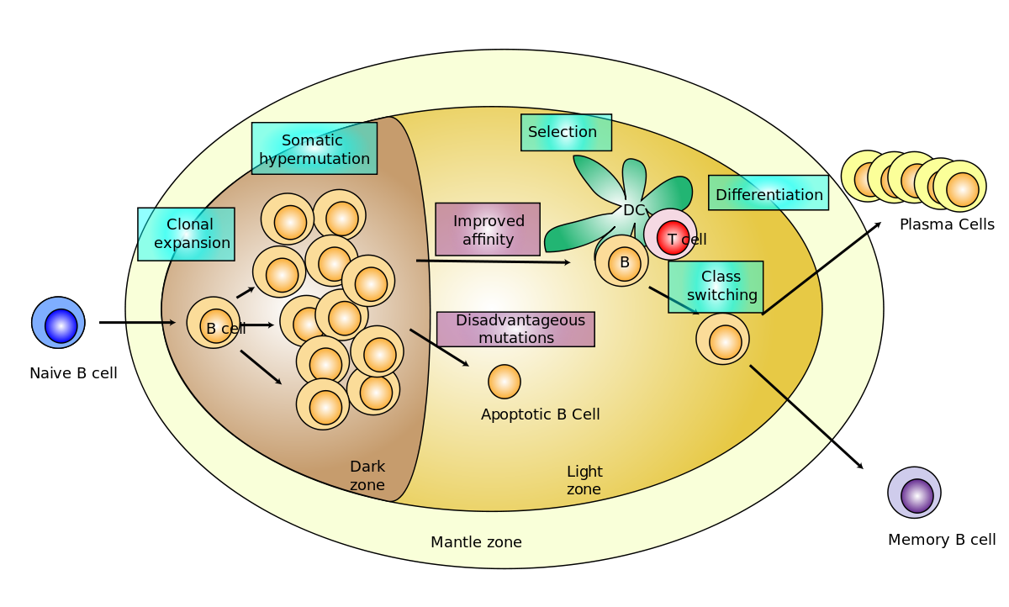
Intro: What is SHM?
In response to the antigen, B-cells follow several steps:
Clonal Expansion
Somatic Hypermutation – SHM
Affinity-Driven Selection
Pathogen
B-Cell
Notes:
להדגיש את זה שהגוף שלנו מפתח את תאי ה-B לאורך חייו

Slide 3
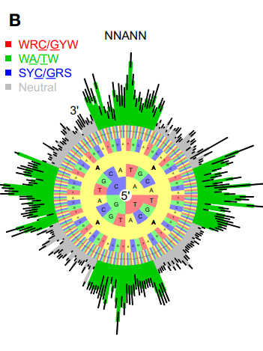
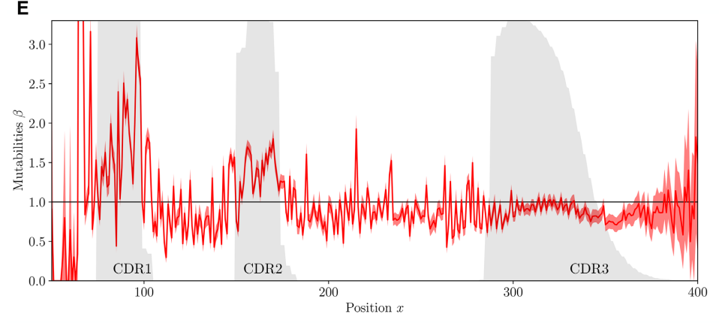

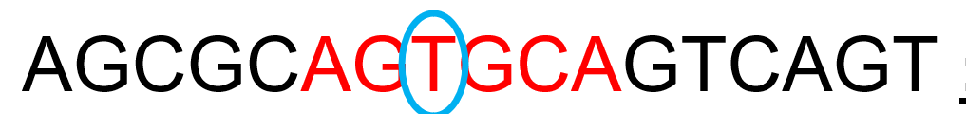
Models to Compare
S5F (G. Yaari,2013)
N. Spisak et al. (2020)
Notes:
להדגיש את זה שיש ערך ביולוגי בהבנה, יחד עם יכולת בזכותה לאתר התנהגויות לא טבעיות / שונות מהרגיל. דבר כזה יכול לשמש לאבחון מחלות.

Slide 4
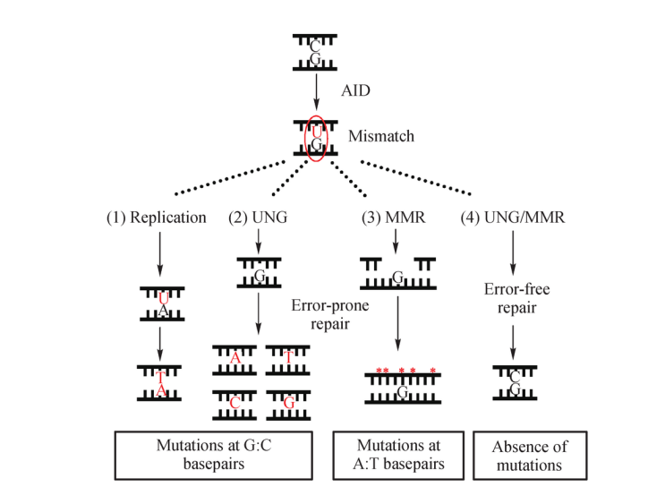
Models to Compare
2PM (D. Einy 2023?)
Our instructor, Daniel, created a model that will bring the statistical analysis closer to the current biological knowledge of SHM.
The model assumes a 2-stage mutation process:
1) AID creates a point mutation, C->U.
2) False MMR (Miss Match Repair) creates mutations surrounding the initial mutation.

Slide 5

Analysis we Have Done – Part 1: Can we neglect the Selection Bias?
Notes:
3 וחצי דקות

Slide 6
The problem of Selection Bias
Our work focused on the different statistical models for mutations occurring during SHM.
When Trying to Model the SHM, we have the problem of the Selection Bias:
Somatic Hypermutation (SHM)
Affinity-Driven Selection
We want to model this
But not this

Slide 7
Overcoming Selection Bias
There are 3 different ways to overcome the bias:
Silent mutations + inferring in motifs with no non-silent mutations
Out-of-frame (unfunctional) sequences
Assuming the bias is insignificant / its effect averages to zero when using a lot of a data
Notes:
להסביר בצורה יותר מורחבת

Slide 8
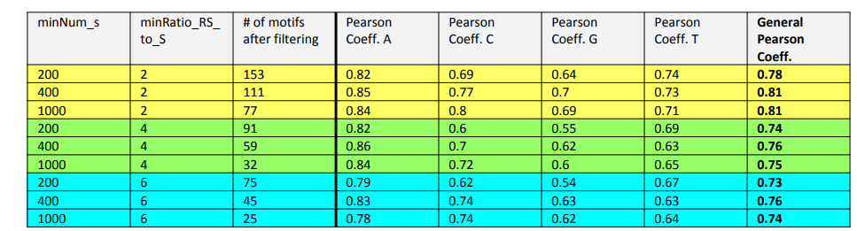
Analysis we Have Done – Part 1: Can we neglect the Selection Bias?
The model that considered all mutations, was based also on the silent mutations – which caused a built-in correlation.
To prevent that, we examined only motifs with a minimal ratio between the total mutations to the silent mutations (“minRatio_RS_to_S” in the picture).
Notes:
minNum_s - מספר המוטציות השקטות המינימלי לכל מוטיב.

Slide 9
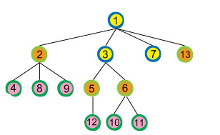
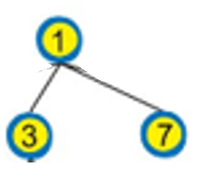
Selection Bias – Shallow Clones
We saw we didn’t receive high correlation, so we tried to check the if the selection bias is weaker in shallow clones, and in sequences that showed less than 10 mutations.
shallow clones - clones with less sequences (we required up to 3 sequences per clone) related to them, and therefore are probably “younger”.

Slide 10
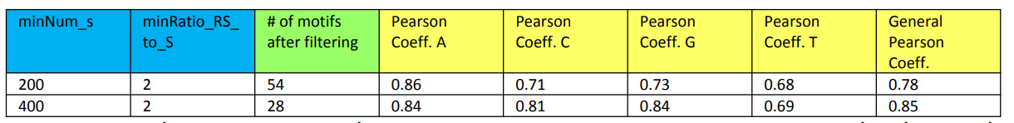
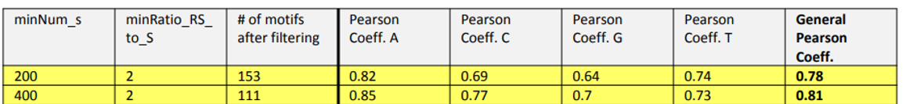
Selection Bias – Shallow Clones
We next tried to check the if the selection bias is weaker in shallow clones, and in sequences that showed less than 10 mutations.
shallow clones - clones with less sequences (we required up to 3 sequences per clone) related to them, and therefore are probably “younger”
All clones:
Notes:
Shallow clones הם צעירים

Slide 11

Analysis we Have Done – Part 2: Comparing the different models
Notes:
5 דקות

Slide 12
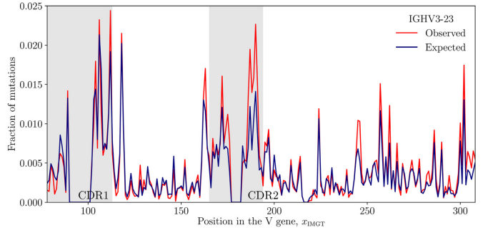
Methods for comparing models
Choosing the right way for the comparison wasn’t “straightforward”.
The “Classic” Way: Observed-vs.-Expected Graphs
Testing on separate “test data”
Calculating expected mutation rate per position vs. observed mutation rate per position
Disadvantage:
Gives advantage to position-dependent models (like Spisak-2020)

Slide 13

The Method we developed
We developed a formula closer to a likelihood score.
$$Likelihood=\prod_{\begin{aligned}all \\ sequences\end{aligned}}^{ }{\prod_{\{i | x\left[i\right]≠y[i]\}}{P(x\left[i\right]≠y\left[i\right] / mutation somewhere)} }$$
$$=\prod_{\begin{aligned}all \\ sequences\end{aligned}}^{ }{\prod_{\{i | x\left[i\right]≠y[i]\}}{\frac{Model(seq\left[i\right])}{\sum_{i}^{ }{Model(seq\left[i\right])}}} }$$
$$Score=\sqrt[\begin{aligned}total \# \#of \\ mutations\end{aligned}]{\prod_{\begin{aligned}all \\ sequences\end{aligned}}^{ }{\prod_{\{i | x\left[i\right]≠y[i]\}}{\frac{Model(seq\left[i\right])}{E_{i}(Model\left(seq\left[i\right]\right))}} }}$$

Slide 14
Validating the score with simulation
Simulating mutations according to one model
Testing all models on the simulated data
Checking that model with which we started gets the highest score
To validate our score, we executed the following procedure:
Notes:
7 וחצי

Slide 15
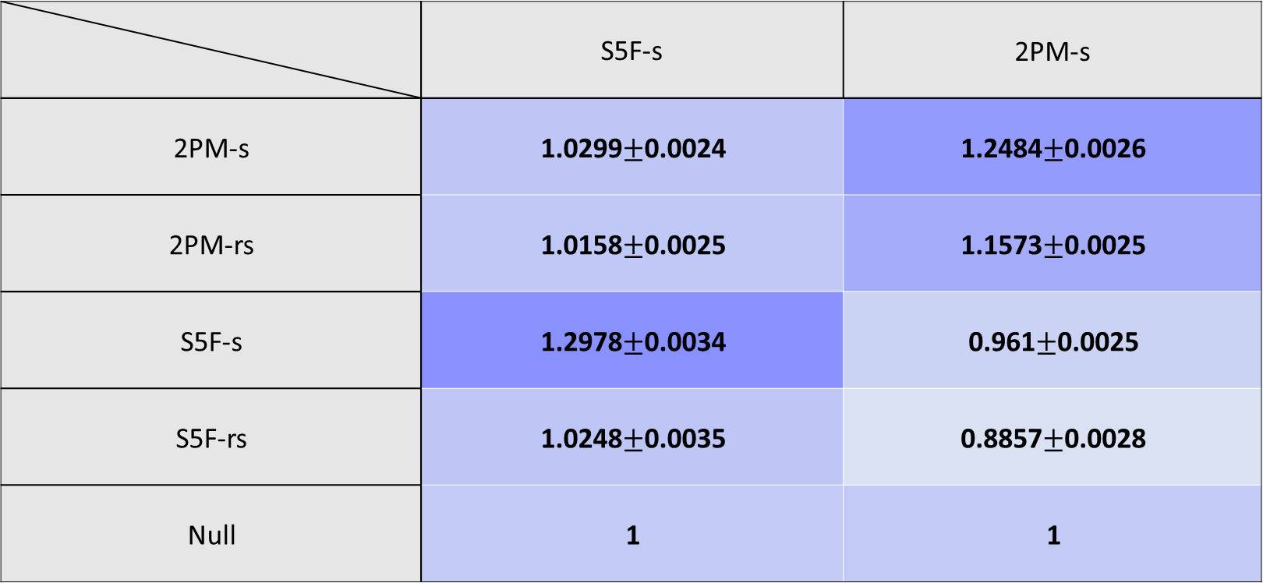
Validation Results
 | S5F-s | 2PM-s
2PM-s | 1.0299$±$0.0024 | 1.2484$±$0.0026
2PM-rs | 1.0158$±$0.0025 | 1.1573$±$0.0025
S5F-s | 1.2978$±$0.0034 | 0.961$±$0.0025
S5F-rs | 1.0248$±$0.0035 | 0.8857$±$0.0028
Null | 1 | 1
Simulated By
Model Tested
Notes:
We can use CI because the central limit theorem on the mean of the results.

Slide 16
Using the score to compare models trained on real data
Score | UPR.CI | LWR.CI | Test data | Train data | model
1.0081 | 1.0109 | 1.0052 | OOF data | Daniel data | 2PM-s
1.0392 | 1.0422 | 1.0361 | OOF data | Daniel data | 2PM-rs
1.0778 | 1.0813 | 1.0742 | OOF data | Daniel data | S5F-s
1.2314 | 1.2266 | 1.2218 | OOF data | Daniel data | S5F-rs
1 | 1 | 1 | OOF data | -- | Null

Slide 17
Conclusions and Future Directions
Part 1:
Selection bias cannot be easily neglected.
Using shallow clones doesn’t help, either.
Part 2:
Using silent mutations gives worse results than when using all mutations.
Less data
Inferring missing 5-mers/
S5F model gives the best likelihood score, between the models we compared.
Future Directions:
We used a basic versions of Daniel’s model; Continuing to compare and test more complete versions of the model.
Widening the use of our score for models, including substitution models.
Full understanding of the factors that have negative impact on silent mutations models.
Using the score to identify different-than-usual behaviors and diagnose diseases.

Slide 18
Using the score to compare models trained on real data
Score | UPR.CI | LWR.CI | Test data | Train data | model
1.1578 | 1.1588 | 1.1558 | Daniel data | Off data | 2PM-rs
1.4334 | 1.437 | 1.4298 | Daniel data | Off data | S5F-rs
1.2977 | 1.3009 | 1.2945 | Daniel data | Off data | Spisak et al.

